Slide 1


Slide 2
New-onset diabetes mellitus after kidney transplantation
Dr. E Nemati
Professor of Nephrology
Tehran/1402

Slide 3
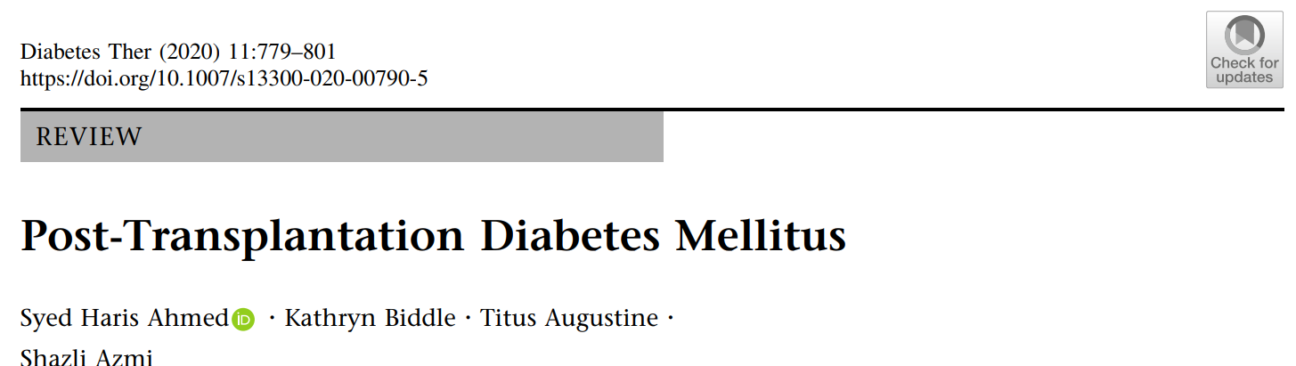
DIAGNOSIS
The consensus recommends delaying the screening and diagnosis of PTDM until at least 45 days after transplantation to allow for immunosuppression levels to be stabilized .
OGTT is the gold standard for diagnosis as this method is able to identify more patients with PTDM than fasting glucose alone.
The difference in pathophysiology between type 2 diabetes mellitus and PTDM means that the detection of PTDM is higher using OGTT.
INTRODUCTION
From the International Consensus Meeting in 2013,
the first recommendation was to change the
terminology back to PTDM, as it was originally known.
This is a more inclusive term for diabetes that is diagnosed after transplantation without specific reference to any previous history of diabetes.

Slide 4
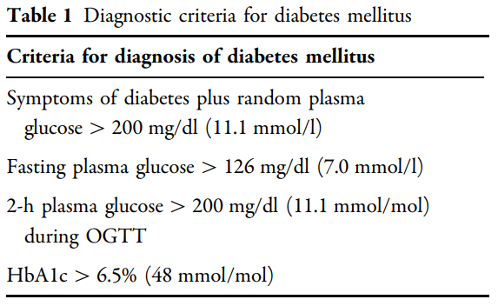
Diabetes Ther (2020) 11:779–801 https://doi.org/10.1007/s13300-020-00790-5

Slide 5
NODAT pathophysiology
The pathophysiology of the development of new onset diabetes after transplantation is not fully understood, though it is recognized that it encompasses dysfunctions of pancreatic beta cells, increased glycogenesis in the liver and coexisting increased insulin resistance.
The distinguishing aspect of new onset diabetes after transplantation is the original pathophysiological defect that is the dysfunction of pancreatic beta cells, whereas type 2 diabetes begins with insulin resistance .
Clinical Diabetology 2020, 9; 5: 356–366
DOI: 10.5603/DK.2020.0047

Slide 6
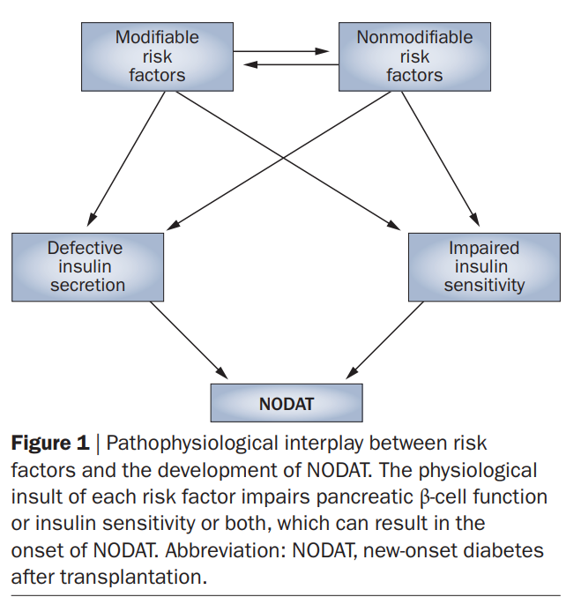
nature reviews | nephrology
© 2010 Macmillan Publishers Limited. All rights reserved

Slide 7
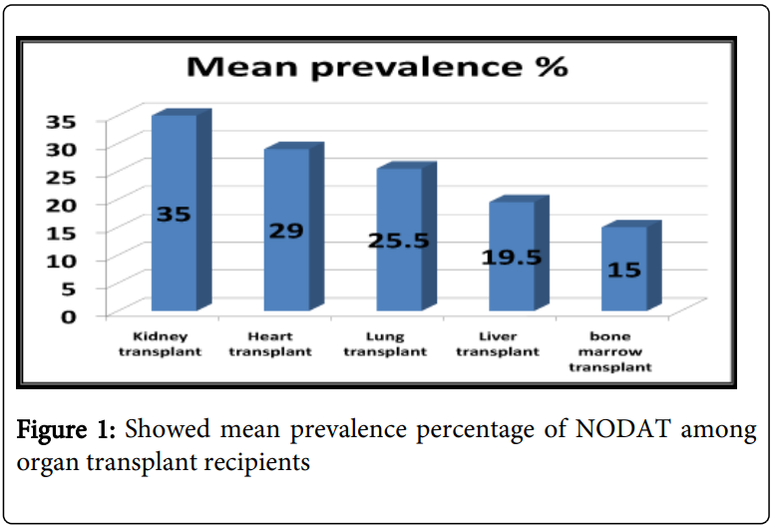
Prevalence
After one year or longer of transplantation, NODAT was diagnosed in 20-50% of kidney transplants, 28-30% of heart transplants, 6-45% of lung transplants, 9-30% of liver transplants, and approximately 15% for bone marrow transplants.
Gheith et al., J Nephrol Ther 2014, S1:005
DOI: 10.4172/2161-0959.S1-005

Slide 8
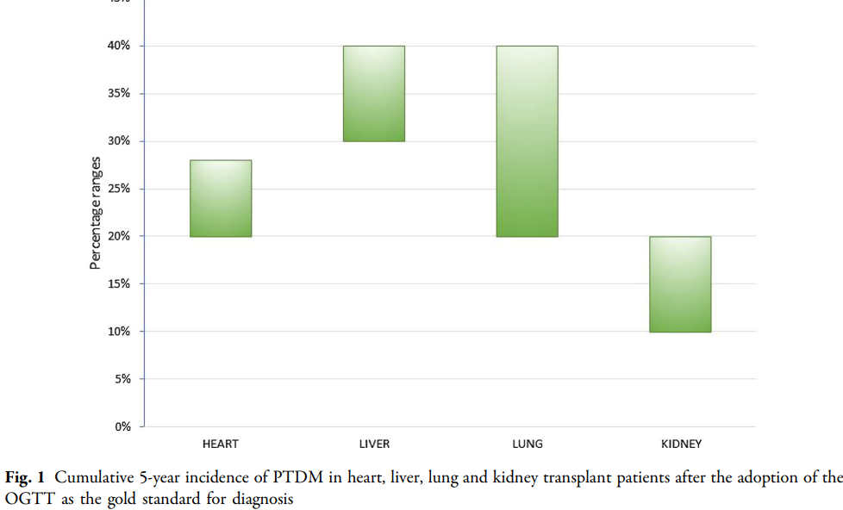
INCIDENCE
The reported rates of PTDM after kidney transplantation are 10–40% .
Vincenti et al. reported an incidence of 20.5% at 6 months after renal transplantation [17].
After heart transplantation, when OGTT has been used as the diagnostic criterion, the incidence has been reported at 20–28% at 5 years .
However, 5 years after liver transplantation the incidence of PTDM is reported at almost 40%.
Diabetes Ther (2020) 11:779–801 https://doi.org/10.1007/s13300-020-00790-5

Slide 9
Assessment for risk factors of diabetes

Slide 10
Pretransplant screening
Assessment for risk factors of diabetes should be searched for once
individuals are placed on the transplant waiting list.
The FPG should be documented, and if it is normal, the updated International Consensus Guidelines recommend doing 75-g OGTT to detect the presence of impaired glucose tolerance (IGT).
A pre transplant finding of IGT or impaired fasting glucose (IFG) is associated with higher risk for NODAT by more than 2.5 folds.
Gheith et al., J Nephrol Ther 2014, S1:005
DOI: 10.4172/2161-0959.S1-005

Slide 11
Perioperative management
Surgical stress and high-dose steroids (used as induction of
immunosuppression) frequently induce early post-transplant
hyperglycemia. Insulin infusion can be used to manage peri-operative
stress hyperglycemia.
The glycemic targets recommended for non-critically ill patients treated with insulin (premeal blood glucose values to be less than 140 mg/dl ,and random glucose values to be less than 180 mg/dl.
Gheith et al., J Nephrol Ther 2014, S1:005
DOI: 10.4172/2161-0959.S1-005

Slide 12
Post transplant monitoring
Patients discharged without hyperglycemia should have FPG
evaluation weekly during the first month, then every 3rd month for 1
yr, and then annually.
If IFG is detected at any time, an OGTT should be done to increase diagnostic succumb; persons identified as having IFG or IGT should receive lifestyle counseling preferably by diabetes educators .
Gheith et al., J Nephrol Ther 2014, S1:005
DOI: 10.4172/2161-0959.S1-005

Slide 13
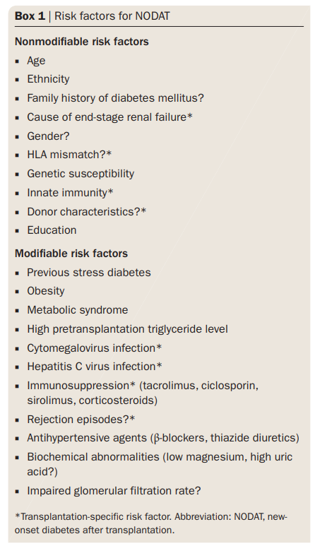
nature reviews | nephrology
© 2010 Macmillan Publishers Limited. All rights reserved

Slide 14
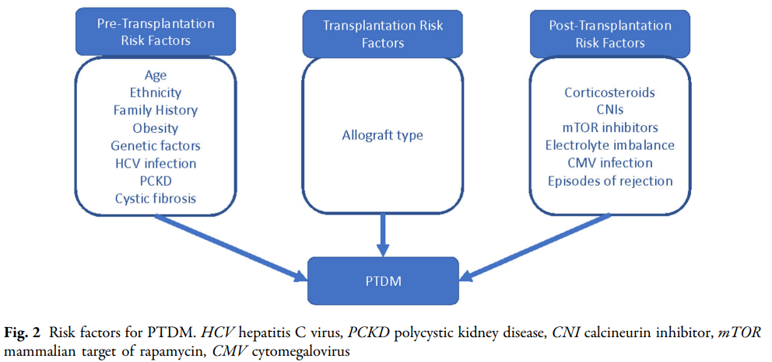
Diabetes Ther (2020) 11:779–801 https://doi.org/10.1007/s13300-020-00790-5

Slide 15
Transplantation-Associated Risk Factors
Allograft-associated factors, including graft
type, have been shown to affect the incidence of PTDM.
It is well established that deceased donor allografts express higher levels of proinflammatory cytokines compared with living donor allografts, and it has been hypothesised that the resulting proinflammatory state predisposes to the development of PTDM.
This is supported by markedly increased rates of PTDM in recipients
of deceased donor grafts compared with living donor grafts, with some studies demonstrating a relative risk of nearly four.
Diabetes Ther (2020) 11:779–801 https://doi.org/10.1007/s13300-020-00790-5

Slide 16
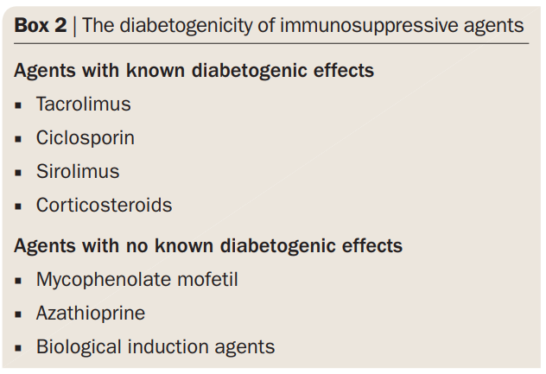


Slide 17
Risk Factors for NODAT
Hepatitis C infection
HCV and HLA-B13 locus had shown to be associated with higher risk of NODAT in liver or kidney transplant recipients .
HCV might induce diabetes through many mechanisms as pro-inflammatory cytokines, oxygen free radicals, and change of signal transduction by viral proteins, in addition to other mechanisms .
Gheith et al., J Nephrol Ther 2014, S1:005
DOI: 10.4172/2161-0959.S1-005

Slide 18
CMV Infection
Evidence that CMV infection plays a role in the pathogenesis of PTDM.
CMV infection is an independent risk factor for the development of PTDM.
CMV infection have been associated with a 4-fold rise in the risk of NODAT possibly due to impairment of insulin secretion .
Possible mechanisms underlying the diabetogenic effects of CMV infection include CMV-mediated destruction of pancreatic beta cell or the production of pro-inflammatory cytokines.
Diabetes Ther (2020) 11:779–801 https://doi.org/10.1007/s13300-020-00790-5

Slide 19
Rejection
Rejection after transplantation has been shown
to predispose to the development of PTDM.
these results are hard to interpret as it is difficult to disentangle the
effects of rejection versus the effects of anti-rejection therapy, which involves high-dose steroid pulses and increased CNIs.
Diabetes Ther (2020) 11:779–801 https://doi.org/10.1007/s13300-020-00790-5

Slide 20
Hypomagnesaemia
Hypomagnesaemia associated with CNI treatment is a known risk factor for PTDM. Randomized controlled trials have so far not
conclusively proven that oral magnesium supplementation in the post-transplant period improves insulin resistance or secretion.
Diabetes Ther (2020) 11:779–801 https://doi.org/10.1007/s13300-020-00790-5

Slide 21
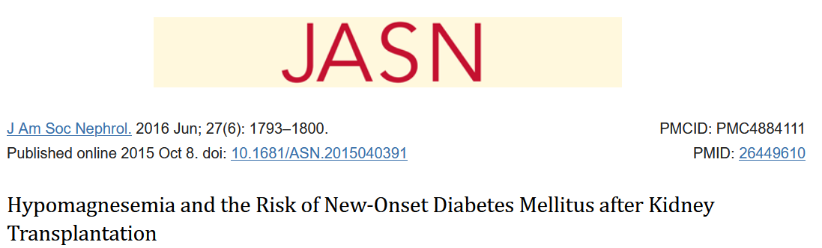
The pathophysiologic relationship between hypoMg and NODAT is complex. A comprehensive review suggested that hypoMg is associated with:
altered cellular transport of glucose,
reduced insulin secretion by β-cells within the pancreas,
defective insulin signaling pathways.

Slide 22
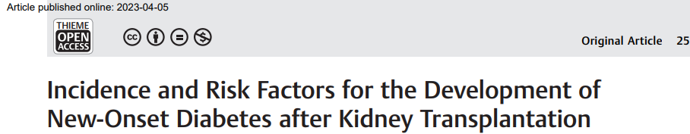
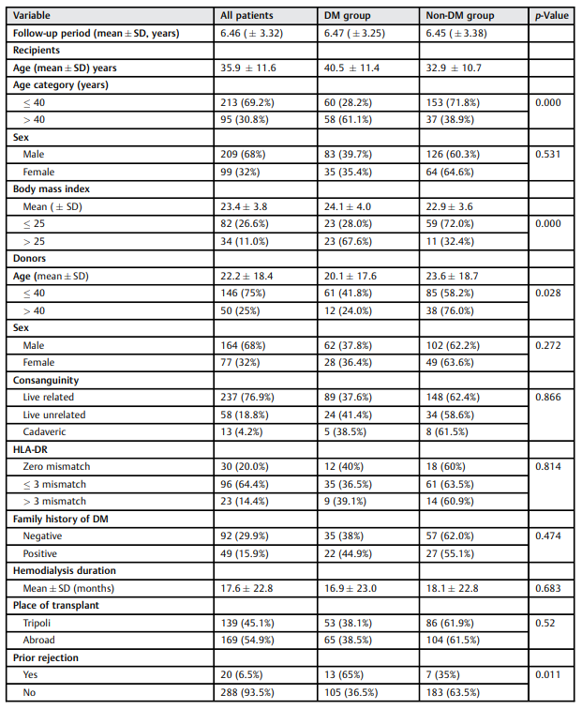
excluding known diabetic patients, second transplant patients, and those with follow-up periods less than 6 months, 308 recipients were included in the study. Demographic, clinical, and
laboratory data were collected from the patient records. The patients were categorized as diabetic or nondiabetic.
This study aimed to determine the incidence of NODAT, the risk factors for its development, and the therapeutic drugs used for its management.
This is an observational, retrospective study on kidney recipients who were followed up in our center in 2021.

Slide 23
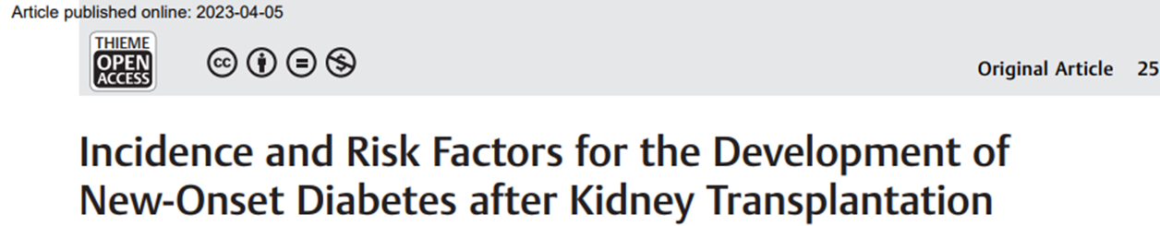
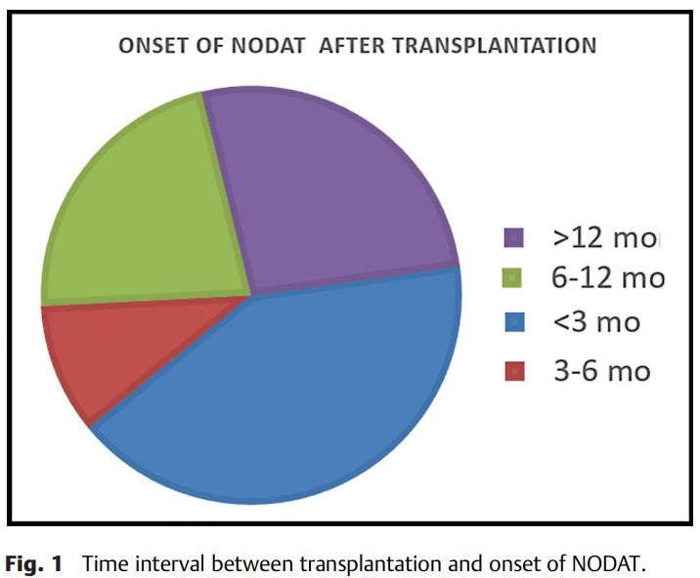
NODAT was diagnosed in 41.3, 32.1, and 26.6% of the patients within 3 months, 3 to 12 months, and beyond 12 months, respectively.

Slide 24

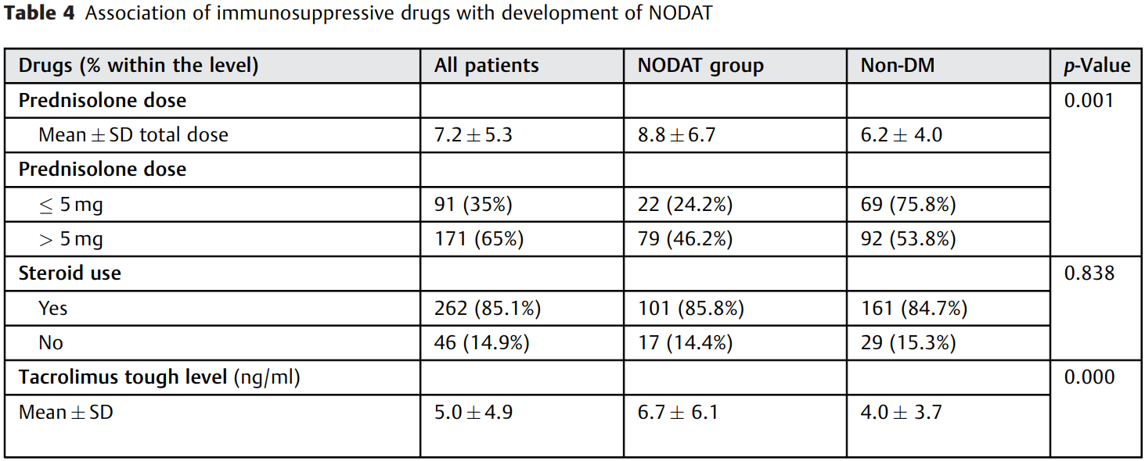
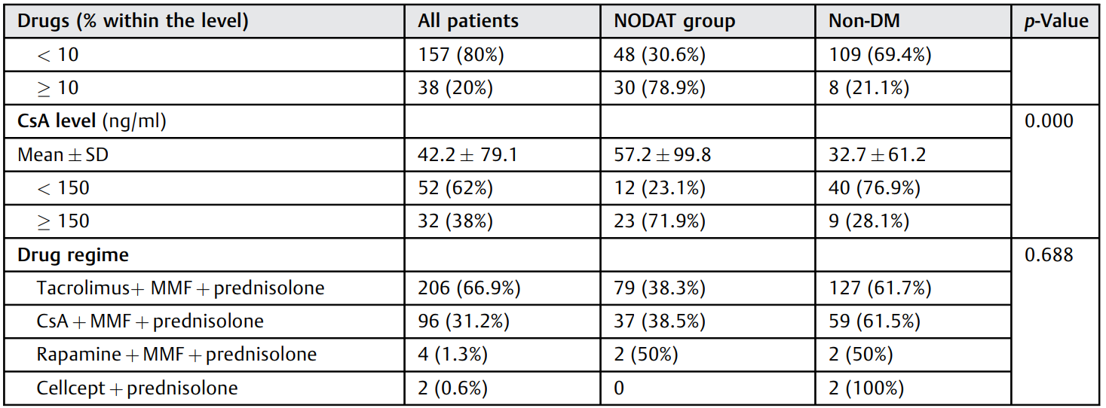
There was no significant association
between the drug regime and the development of NODAT
(p¼ 0.688). However, the drug trough levels were significantly
associated with the development of NODAT. Tacrolimus trough level more than or equal to 10 ng/mL was a significant risk factor for NODAT compared to a level less than 10 ng/mL (p¼ 0.000).
Those with a CsA trough level more than or equal to 150 ng/mL were more likely to develop NODAT than those with lower levels (p¼ 0.000).
Prednisolone more than 5 mg per day was significantly associated with the development of NODAT compared to lower levels (p¼ 0.001;).

Slide 25

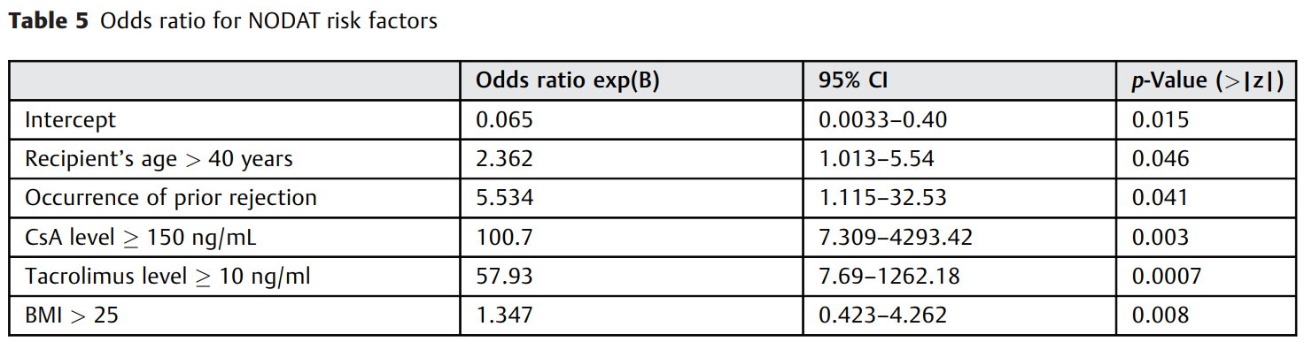
Older age, obesity, previous
rejection episode, high CNIs trough level, and high steroid dose were risk factors for developing NODAT. Predicting the
patients at the highest risk of NODAT based on the tests done
before transplantation is of paramount importance, especially in addressing immunosuppressive drug levels according to a patient’s immunological status, to decrease the
diabetogenic risk of these drugs
identified five factors associated
with an increased risk of NODAT in kidney recipients. These
factors and the fold increase in the risk were as follows: age
more than 40 years (x 2.3), BMImore than 25 (x1.35), prior graft
rejection (x 5.5), tacrolimus level more than or equal to 10 -
ng/mL (x57.9), and CsA level more than or equal to 150 ng/mL

Slide 26
Steroids
Corticosteroids have a dual role in transplant immunosuppression.
High-dose steroids are used in the induction of immunosuppression
perioperatively and lower and tapering doses are used for long-term maintenance therapy.
The mechanisms underlying corticosteroid-induced diabetes include,
impaired insulin sensitivity, increased hepatic gluconeogenesis and appetite stimulation with resulting weight gain.
Diabetes Ther (2020) 11:779–801 https://doi.org/10.1007/s13300-020-00790-5

Slide 27
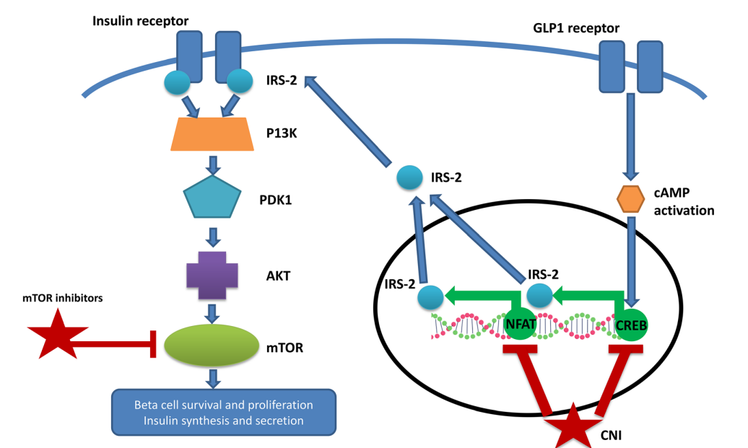
CNI and mTORis affect
At a molecular level, calcineurin is thought to play an important role in the survival of beta cells in the pancreas through the activation of the transcription factors nuclear factor of activated T-cells (NFAT) and cAMP response element binding protein (CREB).
CREB is believed to mediate the proliferative effects of glucagon-like peptide (GLP-1) and transgenic mice that express a dominant negative CREB protein develop diabetes with apoptosis of beta cells secondary to reduced insulin receptor substrate (IRS2) expression.
Diabetes Ther (2020) 11:779–801 https://doi.org/10.1007/s13300-020-00790-5

Slide 28
Progress of new-onset diabetes after liver and kidney transplantation
Studies have confirmed that islet b cells contain a large amount of tacrolimus cytoplasmic receptor-FKBP-12, and high concentrations of FKBP-12 promote the aggregation of FK506 in b cells and their combination into the FK506-FKBP-12 complex, inhibiting calcineurin activity and the activation of glucose and the extracellular K+ insulin gene promoter, interrupting insulin mRNA transcription and reducing insulin secretion.

Slide 29
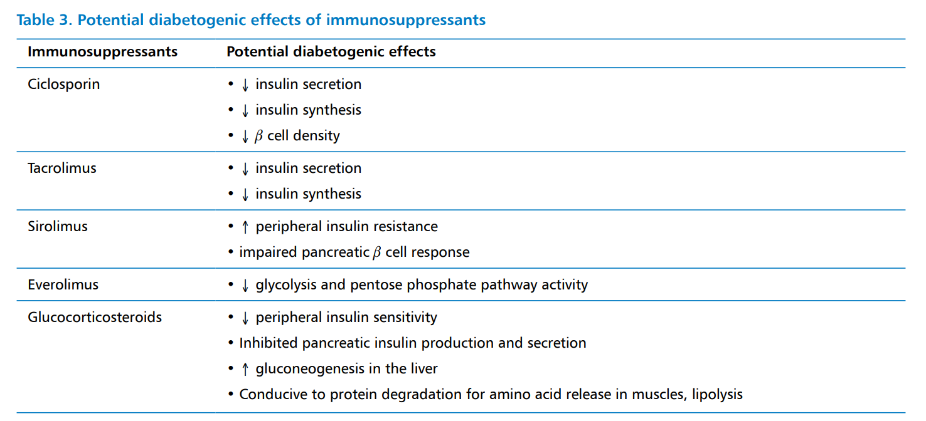
Clinical Diabetology 2020, 9; 5: 356–366
DOI: 10.5603/DK.2020.0047

Slide 30
Immunosuppressive Regimen
There is no agreement concerning which immunosuppressive regimen capable of preventing NODAT; however, studies aimed at CNI minimization in patients receiving potent induction therapy are enduring.
The gold standard of transplant management is optimal
immunosuppression without untoward adverse effects through
cautious use of these agents.
Gheith et al., J Nephrol Ther 2014, S1:005
DOI: 10.4172/2161-0959.S1-005

Slide 31
Complications of NODAT
NODAT might unfavorably affect clinical outcomes of transplant recipients.
renal allograft loss,
precipitation of infections,
cardiovascular co-morbidities,
increased mortality among renal transplant recipients .
The renal hyper filtration associated with diabetes,
micro-angiopathies faster than patients with non-transplant-related diabetes .
Gheith et al., J Nephrol Ther 2014, S1:005
DOI: 10.4172/2161-0959.S1-005

Slide 32
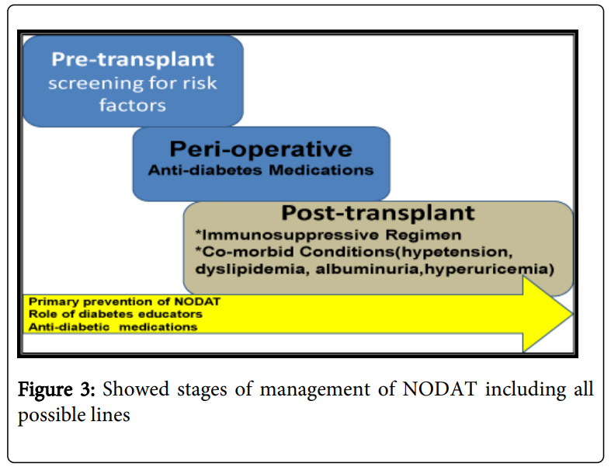
Gheith et al., J Nephrol Ther 2014, S1:005
DOI: 10.4172/2161-0959.S1-005

Slide 33
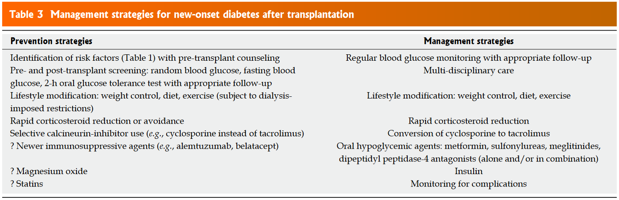
World J Diabetes 2015 April 15; 6(3): 445-455
ISSN 1948-9358 (online)

Slide 34
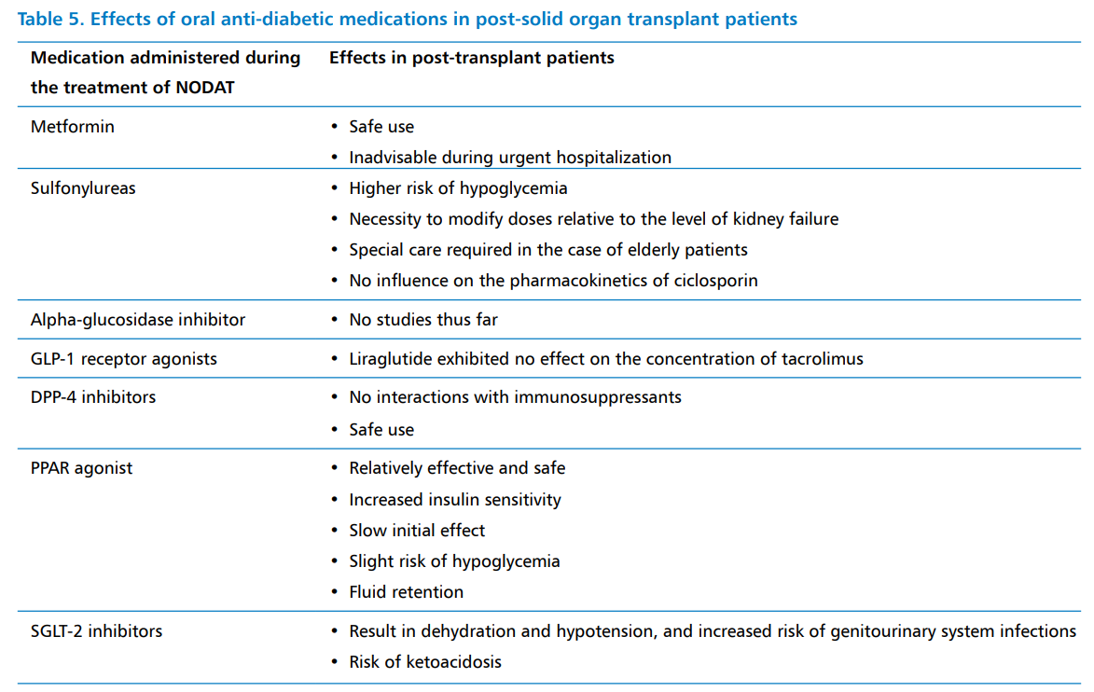
Clinical Diabetology 2020, 9; 5: 356–366
DOI: 10.5603/DK.2020.0047

Slide 35
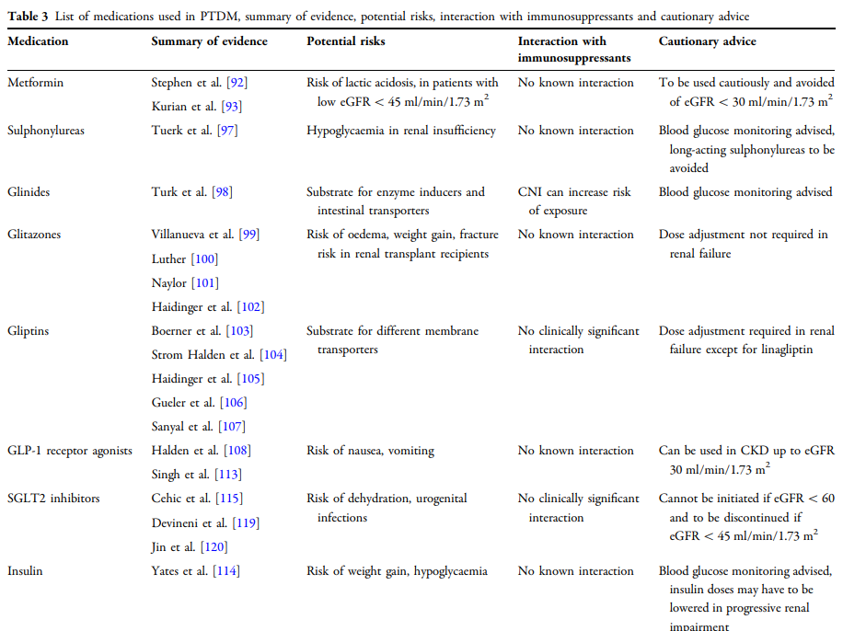

Slide 36


